Slide 1
GIS and Spatial Analytics QMSS 5070
Lecture 2

Slide 2
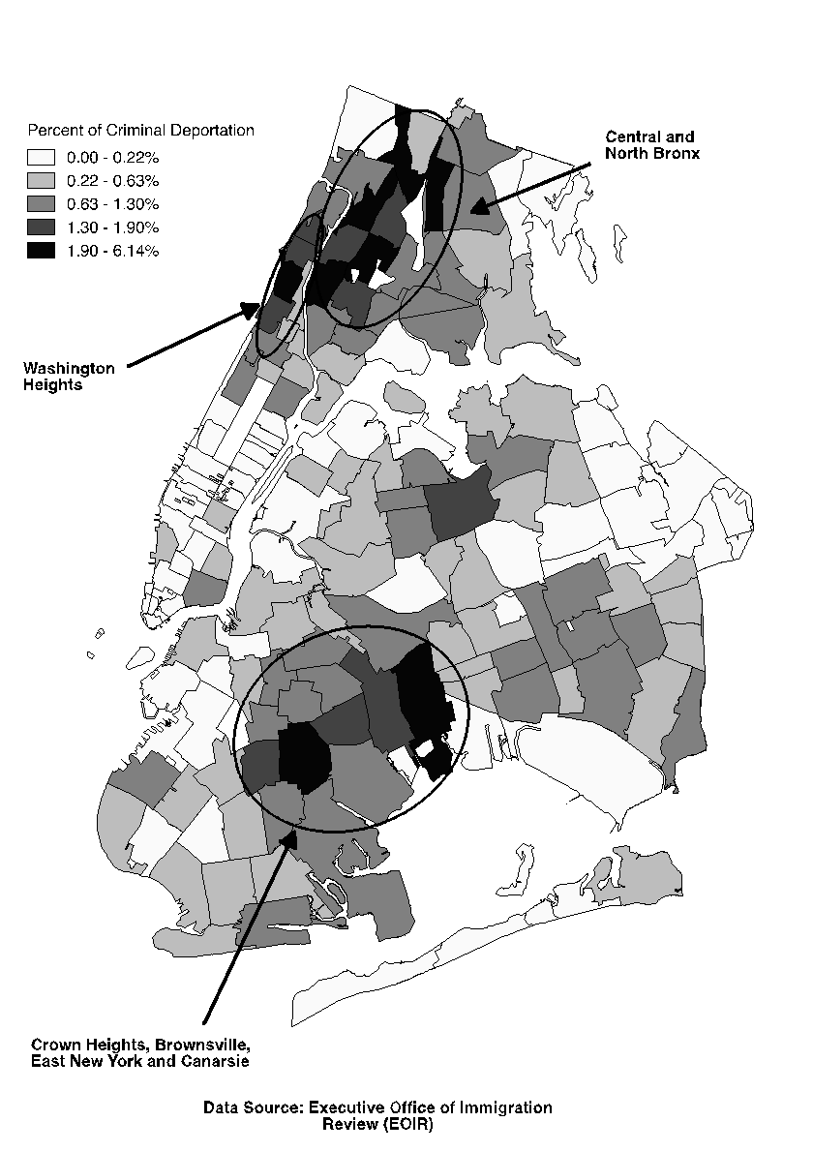
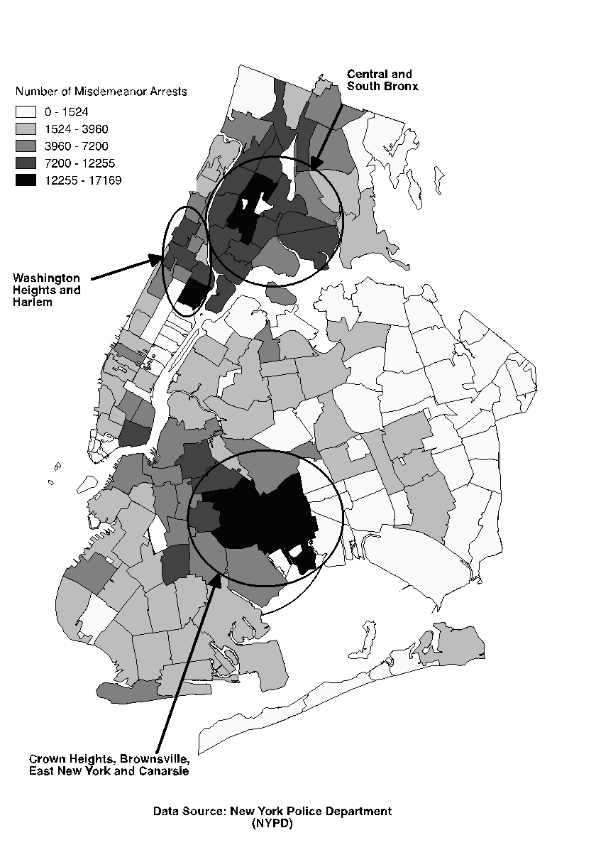
Geographical Distributions of Deportations and Misdemeanor Arrests, New York City 2006-2020
Harlem: 60.6% Dominican; 19.2% of African descent
South/Central Bronx: 37.5% Dominican; 13% Jamaican; 22% of African descent
Cen. Brooklyn: 17% Jamaican; 29% Trinidadian, Haitian, or Guyanese; 11.8% Dominican

Slide 3
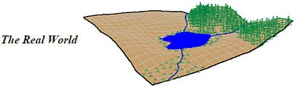
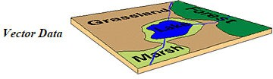
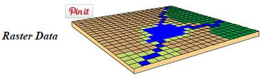
Geospatial Data Types
Geospatial or coordinate data can be represented in two different data formats:
Vector:
e.g. points, lines, and polygons
Raster:
e.g. row and column matrix
23

Slide 4
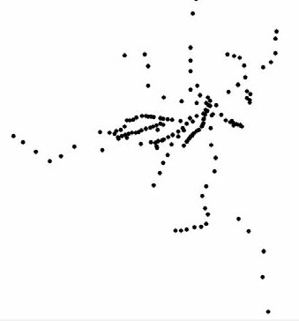
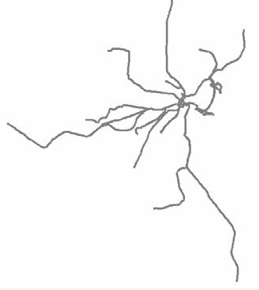
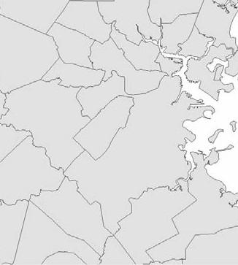
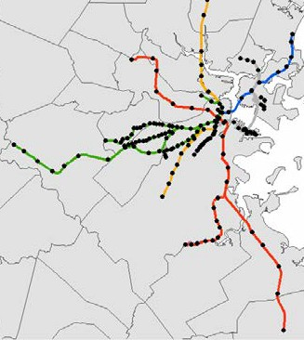
Data Types: Vector examples
Points
Lines
Polygons
(Combined)

Slide 5

Data Types: Vector file formats
The shapefile is the most common vector file format.
“A” shapefile is actually a collection of several different files with different extensions.
Shapefile =
.shp .shx .sbx
.dbf .prj
When adding files to QGIS, you will only see one file, not every extension.
Make sure to keep all files together when moving.

Slide 6



Data Types: Tabular file formats
GIS software can read commonly used tabular formats in order to transform them into spatial data.
.csv
.xlsx
.dbf
Shapefiles include a
.dbf, which is a
tabular format that can be opened in other software, like Excel.
QGIS cannot read Excel file formats.

Slide 7
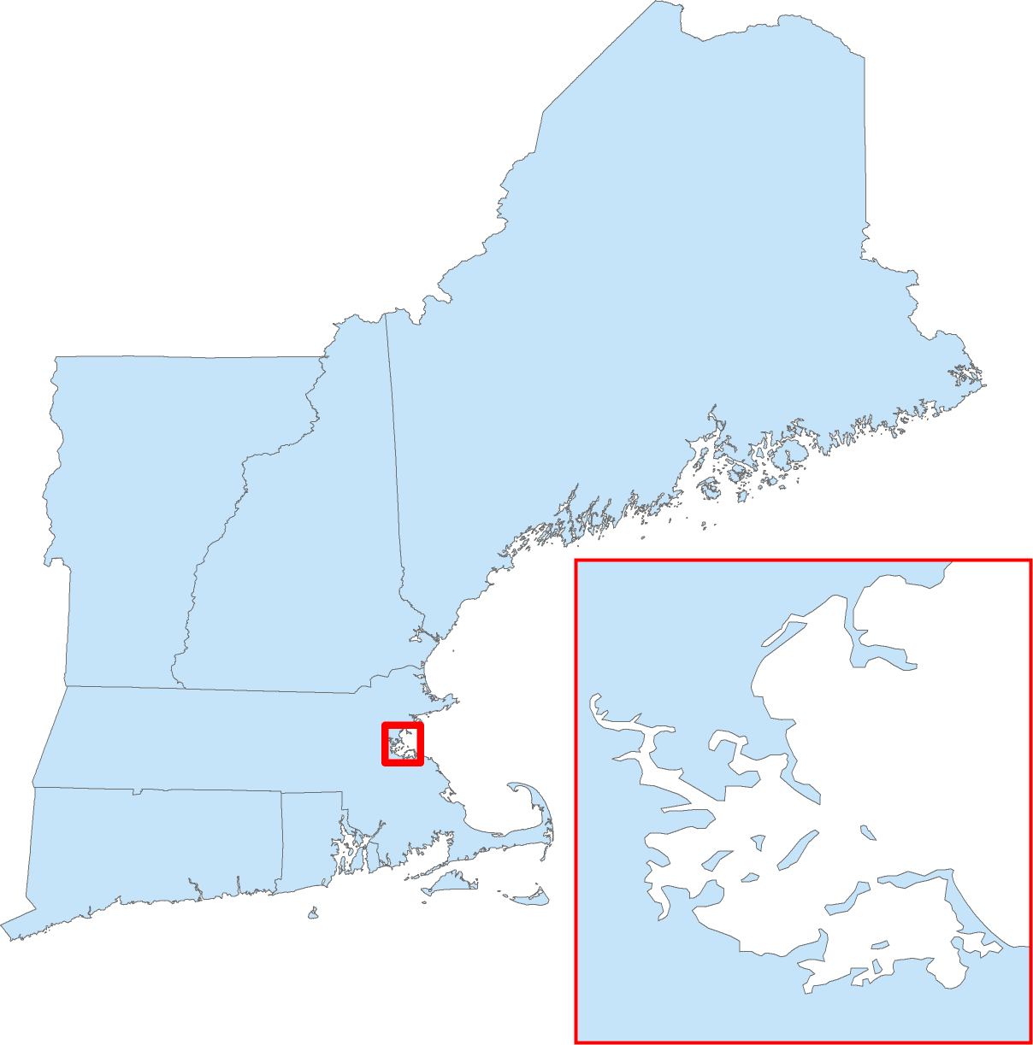
Data Types: Vector mapping
Vectors have a frontend geometry
In this example the geometry represents state polygons

Slide 8
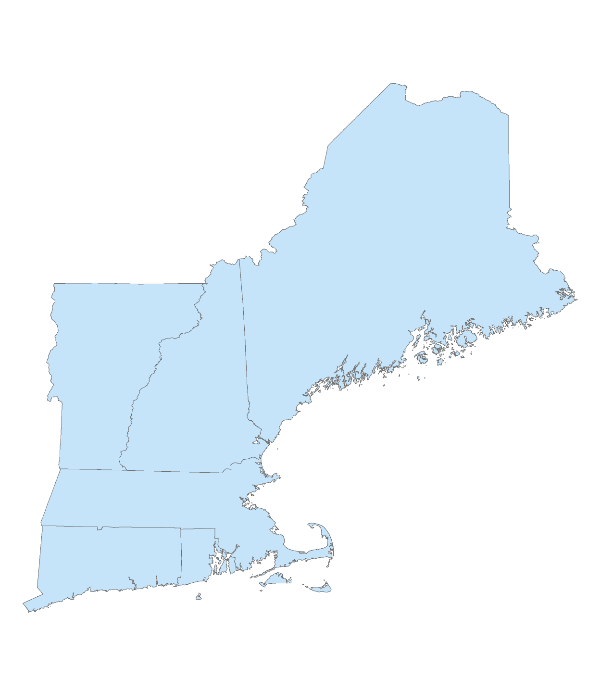
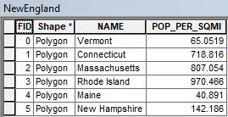
Data Types: Vector mapping
Vectors have a backend database, normally called an ‘attribute table’
rows represent unique geometries (e.g. state polygons)
columns represent
a number of variables (theoretically infinite)
is
8

Slide 9
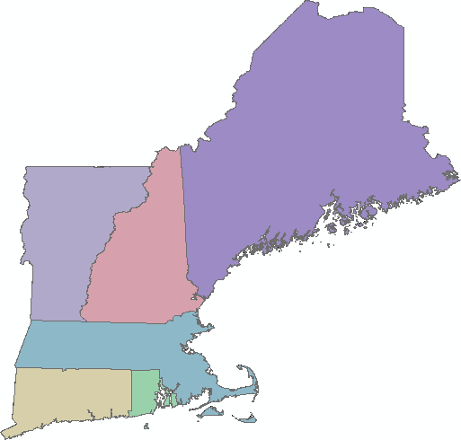
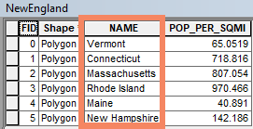
Data Types: Vector mapping
Vectors have a backend database, normally called an ‘attribute table’
Here each state is being symbolized by ‘NAME’
(qualitative variable)
9

Slide 10
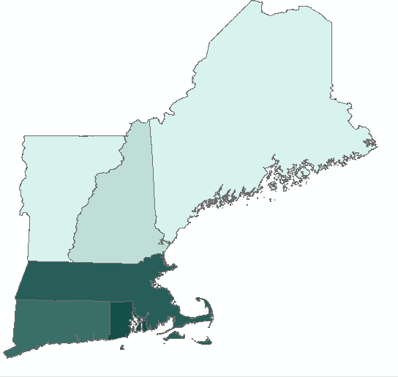
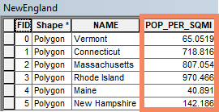
Data Types: Vector mapping
Vectors have a backend database, normally called an ‘attribute table’
Here each state is being symbolized by ‘POP_PER_SQMI’
(quantitative variable)
29

Slide 11

Other data formats
GIS can import and convert data produced in other formats:
KML / KMZ files (Google Earth)
DXF / DWG (CAD)
NetCDF (scientific data)
LAS (Lidar)
GPX (GPS units)
Geojson
GIS software can export many formats:
Adobe Illustrator
KML
CAD
TIF
JPG
The GIS & Data Lab has many types of data visualization software.

Slide 12
Making Great Maps
Cartography is the art and science of making maps
Maps are always simplifications of reality, which makes them helpful when making decisions or explaining patterns
Maps are designed by people (who have intentions), so we have to create them responsibly

Slide 13
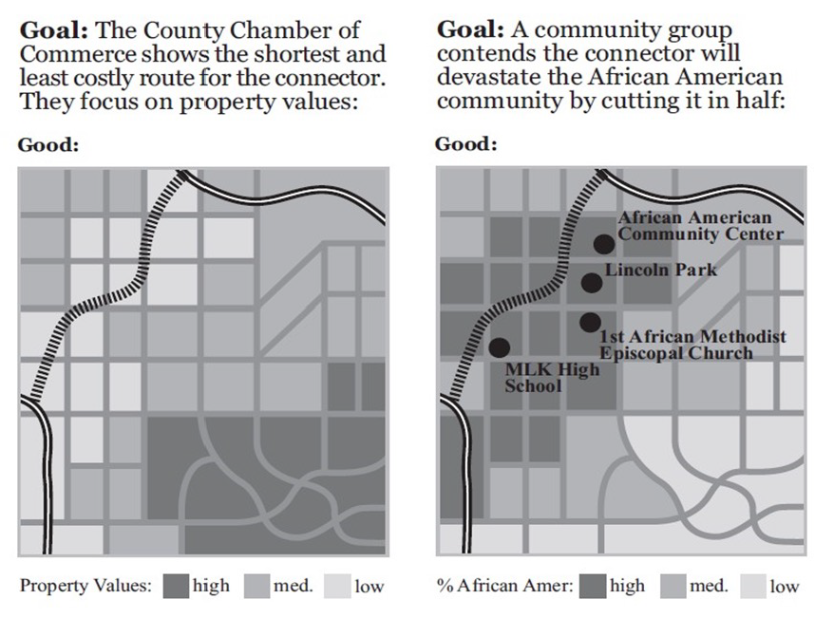
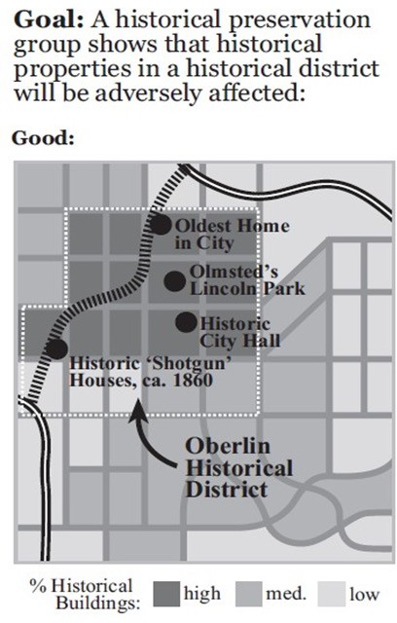
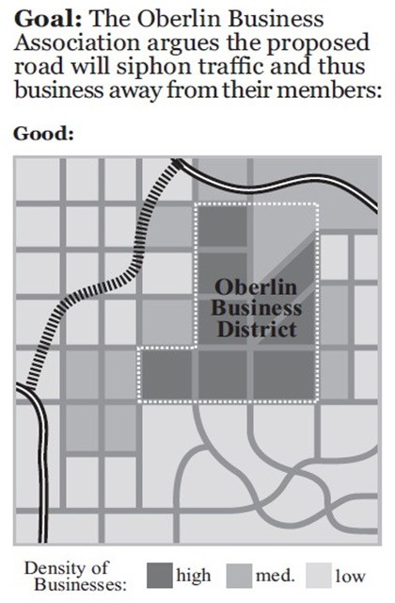
Making Great Maps
From: Making Maps: A Visual Guide to Map Design for GIS by John Krygier and Denis Wood
Example of how a map can be used to prove many different points.
However in the past only those in power had the software and data to do so.
Images © John Krygier and Denis Wood. All rights reserved. This content is excluded from our Creative Commons license. For more
54
information, see https://ocw.mit.edu/help/faq-fair-use/

Slide 14
Three Key Questions
Who wants the map?
e.g. experts (detailed), students (contextual), the community (interactive)
Where will it be seen?
e.g. 8x11 paper (static small, room for main points)
e.g. 30x40 poster board (static large, room for detail)
e.g. web map (interactive, users control navigation of map)
What is it’s purpose?
e.g. to show a variable through time (time series)
e.g. to show change over time (change detection)
e.g. to combine multiple variable into an index to pick best/worst (sustainability/risk/vulnerability mapping, site selection)
Each question deserves a well-thought answer before mapping

Slide 15
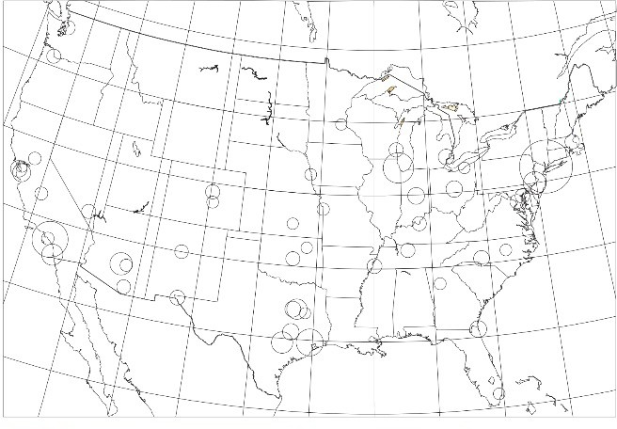
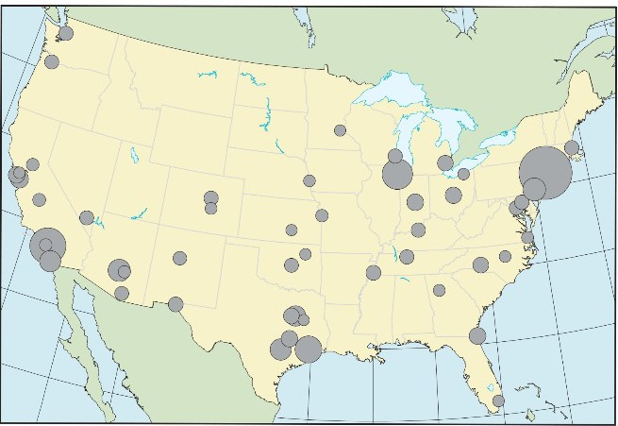
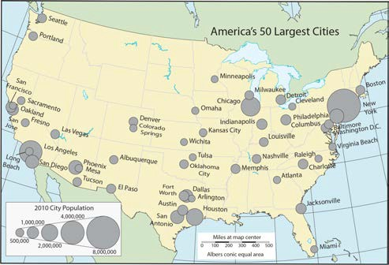
Map Design Process
Start with assembling the data from multiple sources
Next choose the data, analyses, & symbolization
Lastly insert the title, legend, north arrow, scale bar, & labels

Slide 16
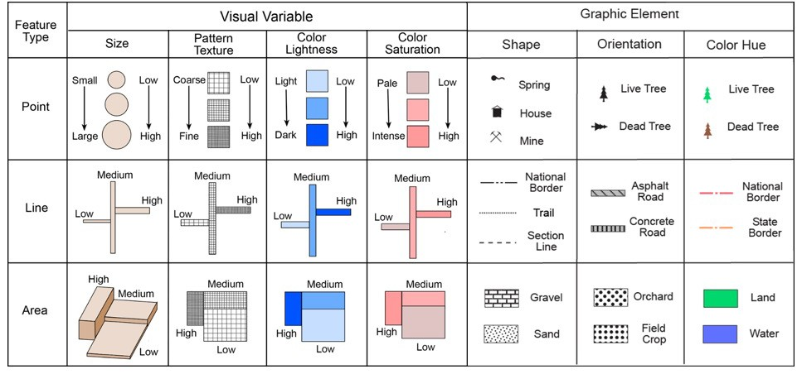
Vector Symbolization
From: Making Maps: A Visual Guide to Map Design for GIS by John Krygier and Denis Wood - makingmaps.owu.edu
57
information,

Slide 17
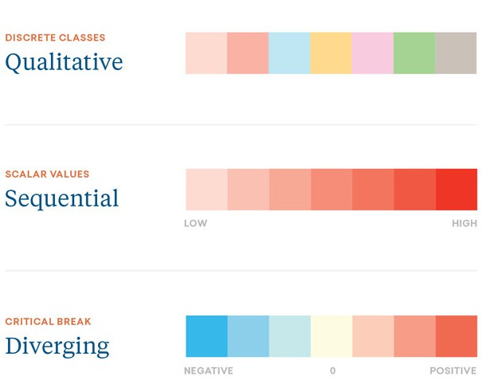
Choosing Color Tips
Match the type of data to the type of color scheme:
Qualitative (categories)
Quantitative (numbers)
59

Slide 18
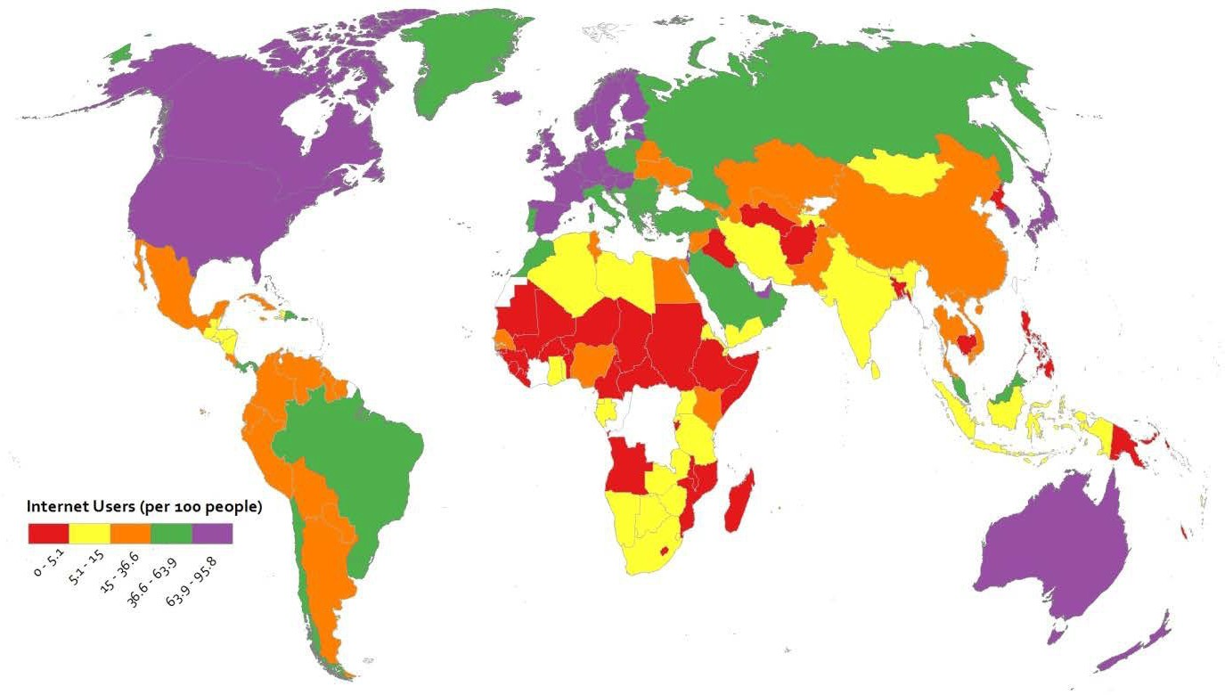
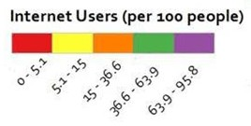
Qualitative Color Example
Does this make sense for the data?

Slide 19
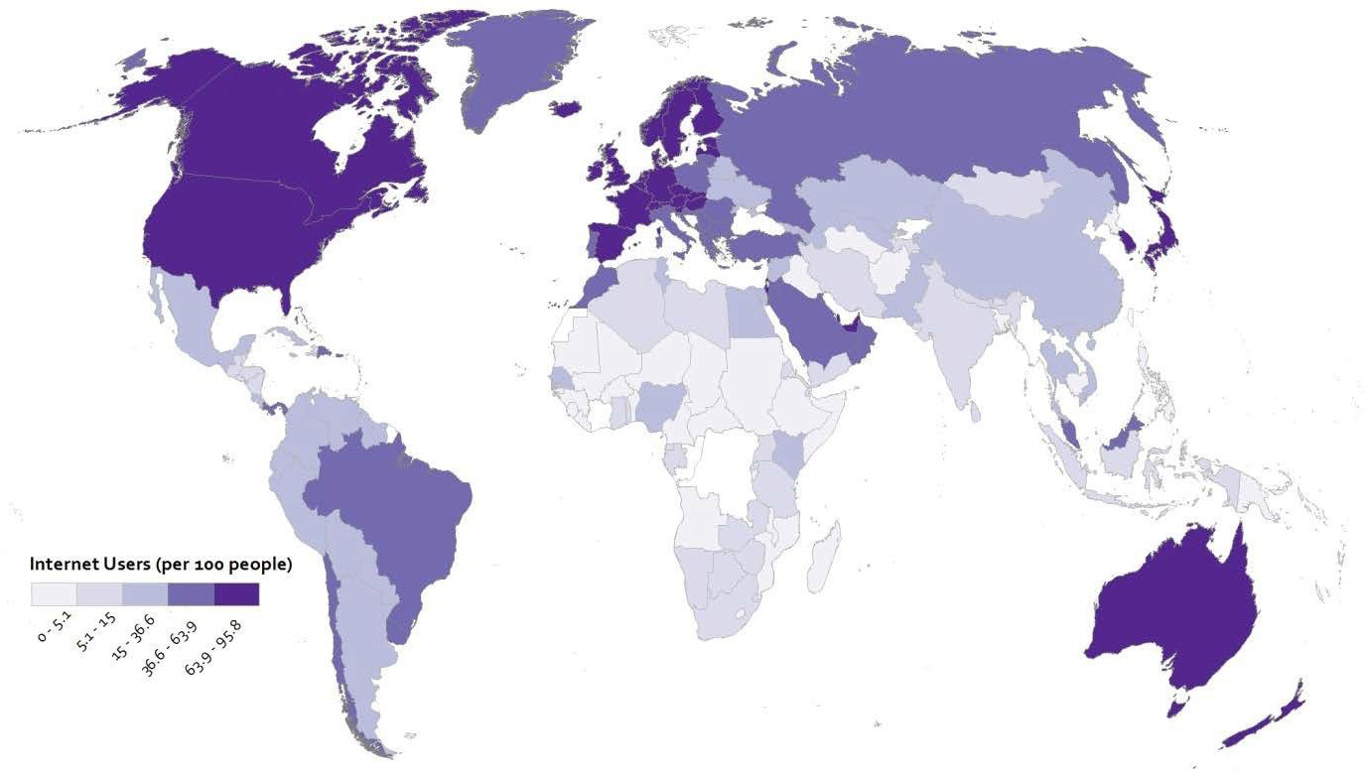
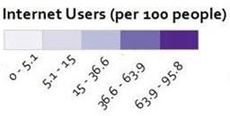
Sequential Color Example
Does this make sense for the data?

Slide 20
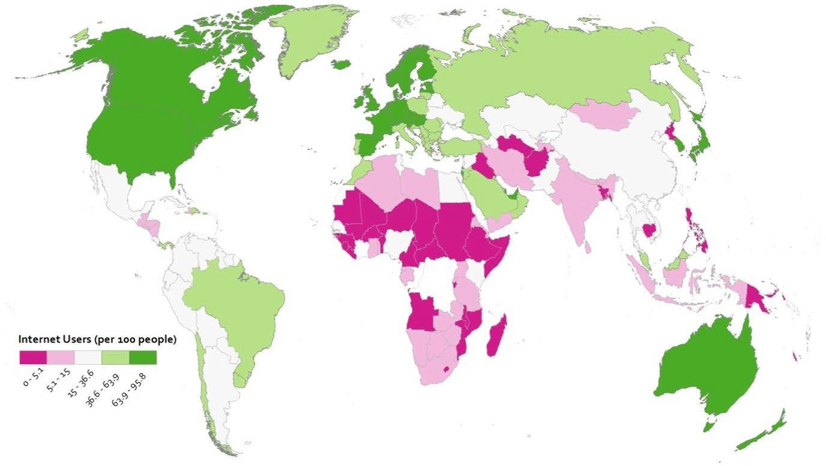
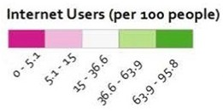
Diverging Color Example
Does this make sense for the data?

Slide 21
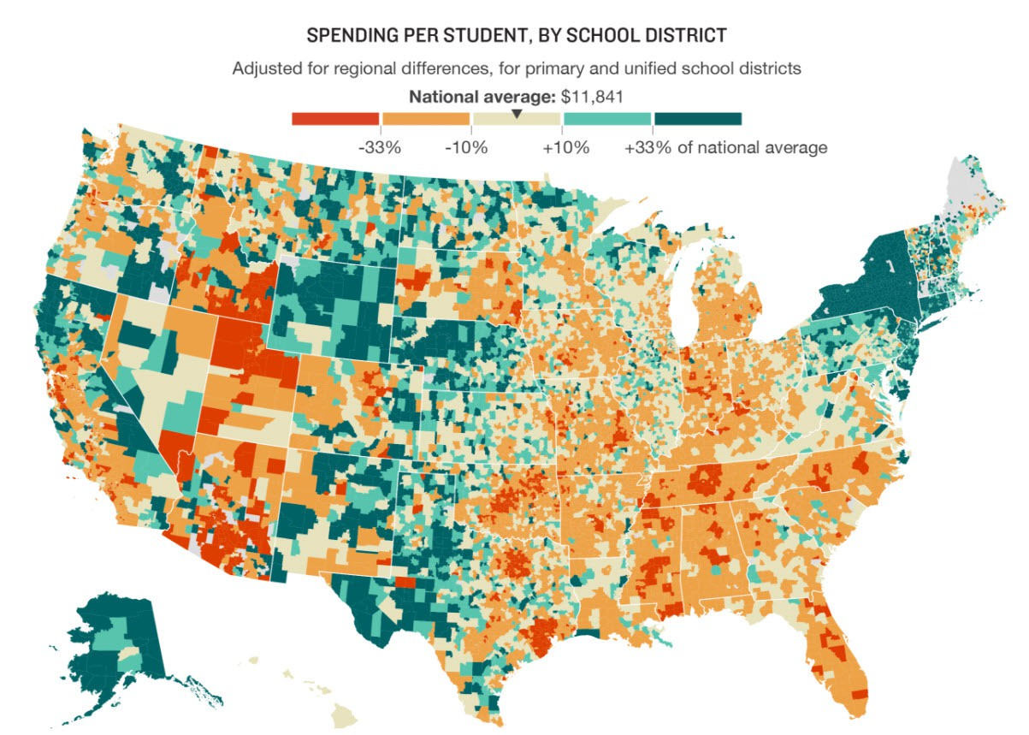
Commonly used map type: Choropleth
These use different shading and coloring to display the quantity or value in defined areas.

Slide 22
Map Design Process
Start with assembling the data from multiple sources
Next choose the data, analyses, & symbolization
Lastly insert the title, legend, north arrow, scale bar, & labels

Slide 23
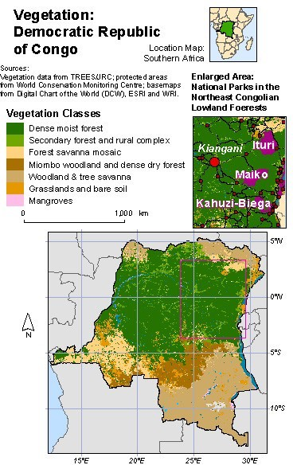
Map Layout Design Example
Overview:
Map layout design is about developing a balanced arrangement
Maps, title, legend, scale bar, labels,
etc. all need relative positioning & sizing
Goal is to design the map layout to support your design questions
Who wants the map
Where will it be seen
What is its purpose
From: Designing Better Maps: A Guide for GIS Users by Cynthia A. Brewer
68

Slide 24


Choropleth map choices
1. Number of Classes 2. Classification Method
Aggregates data for display
More classes = more variation (best to have no more than 7; 4-7 classes best)
Data classification is how data is arranged into separate classes.
Major types
Equal Intervals
Quantile (Equal Count)
Natural Breaks
Defined Intervals

Slide 25
Classification Methods
Equal Interval = classes have equal ranges
Quantile = classes have equal counts
Natural Breaks = optimizes class variation
Manual = you define classes

Slide 26
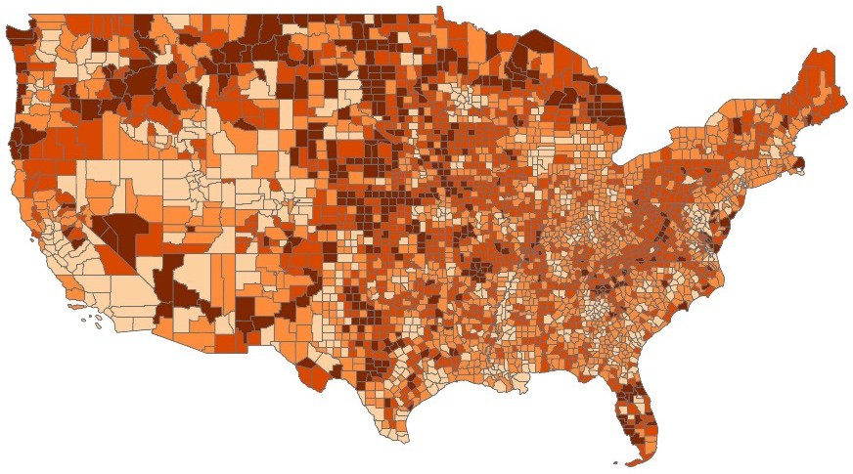
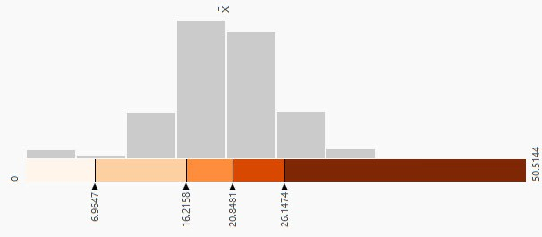
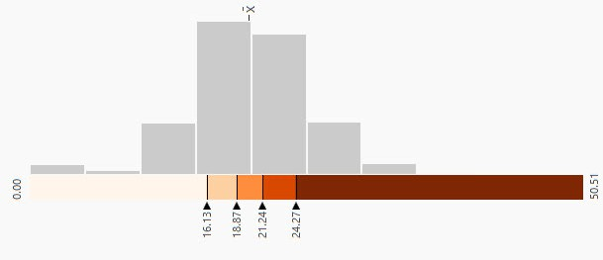
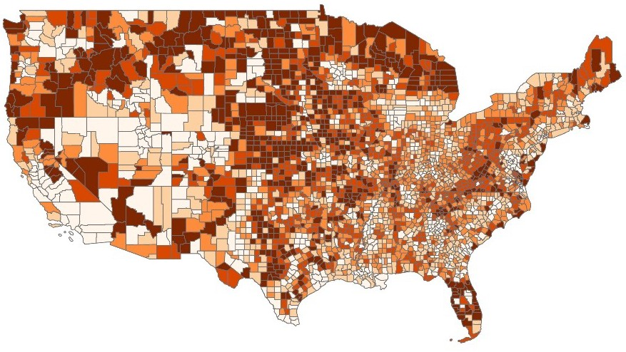
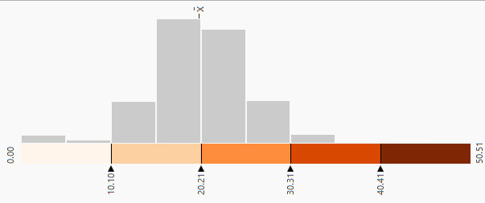
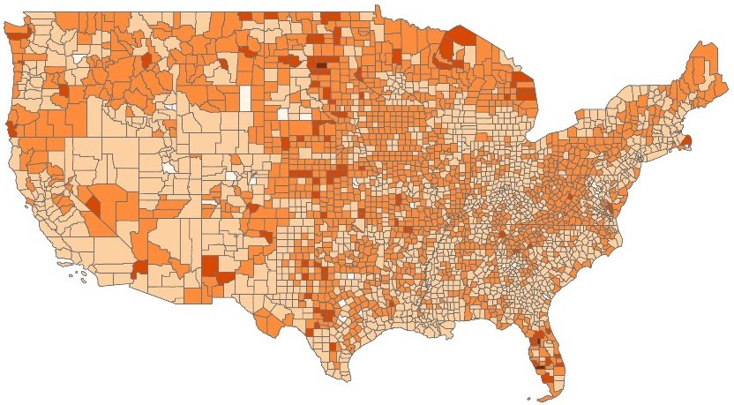
Natural breaks
Quantile
Equal interval

Slide 27
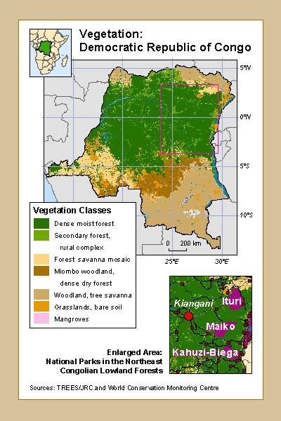
Map Layout Design Example
Tips:
Inset/locator maps are often placed in the top/bottom corners (e.g. continent view top left and zoomed view in bottom right).
Main map often placed in center (usually largest & most detailed).
Legend is tucked into the main map for easy comparison with the data.
Scale bars and north arrows shouldn’t be a distraction from the main map.
Sources should run along the bottom.
69

Slide 28
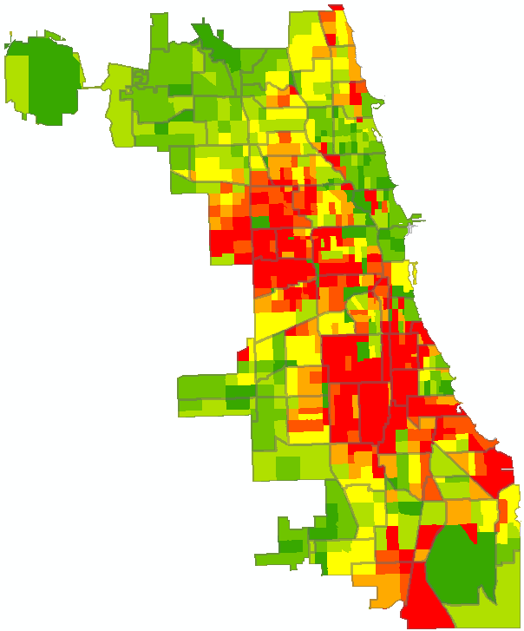
Choropleth: Families Below Poverty in Chicago
Socioeconomic
2000 Census data
Unit – Census Tract
% Families below poverty level
WEST & EAST
GARFIELD PARK
FULLER PARK &
GRAND BOULEVARD
AUSTIN
NORTH
LAWNDALE
WASHINGTON
HEIGHT
NEW CITY
WEST
ENGLEWOOD
ENGLEWOOD
©
RIVERDALE

Slide 29
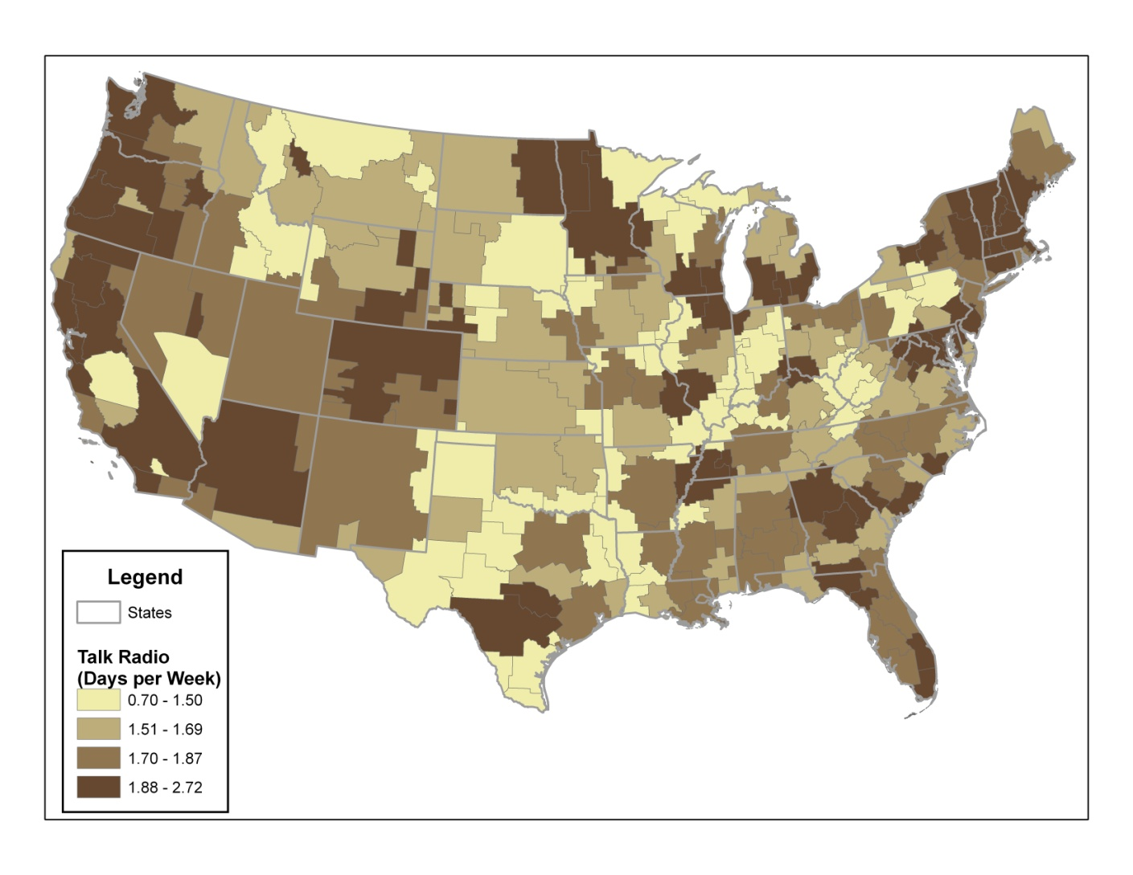
Choropleth: Talk Radio Consumption

Slide 30
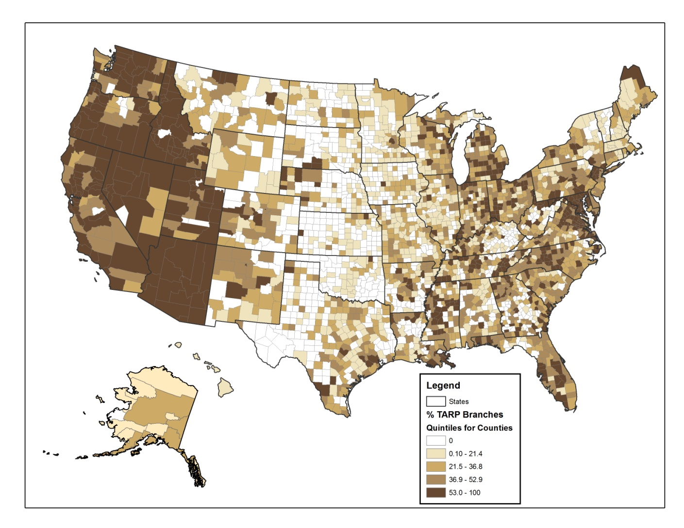
Choropleth: % of Bank Branches Receiving TARP Bailout Funds

Slide 31
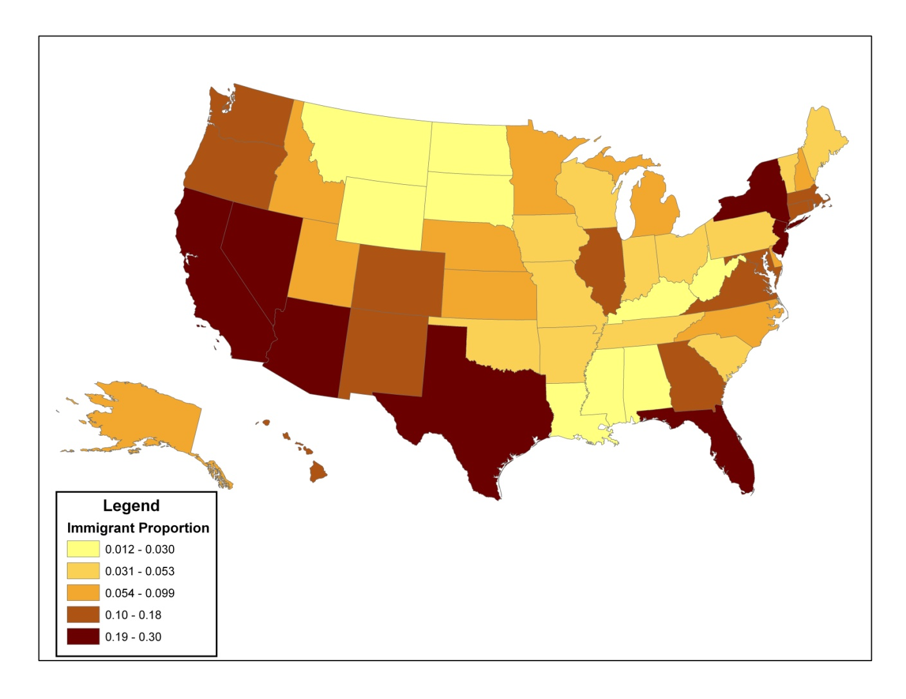
Choropleth: % Immigrant by State

Slide 32
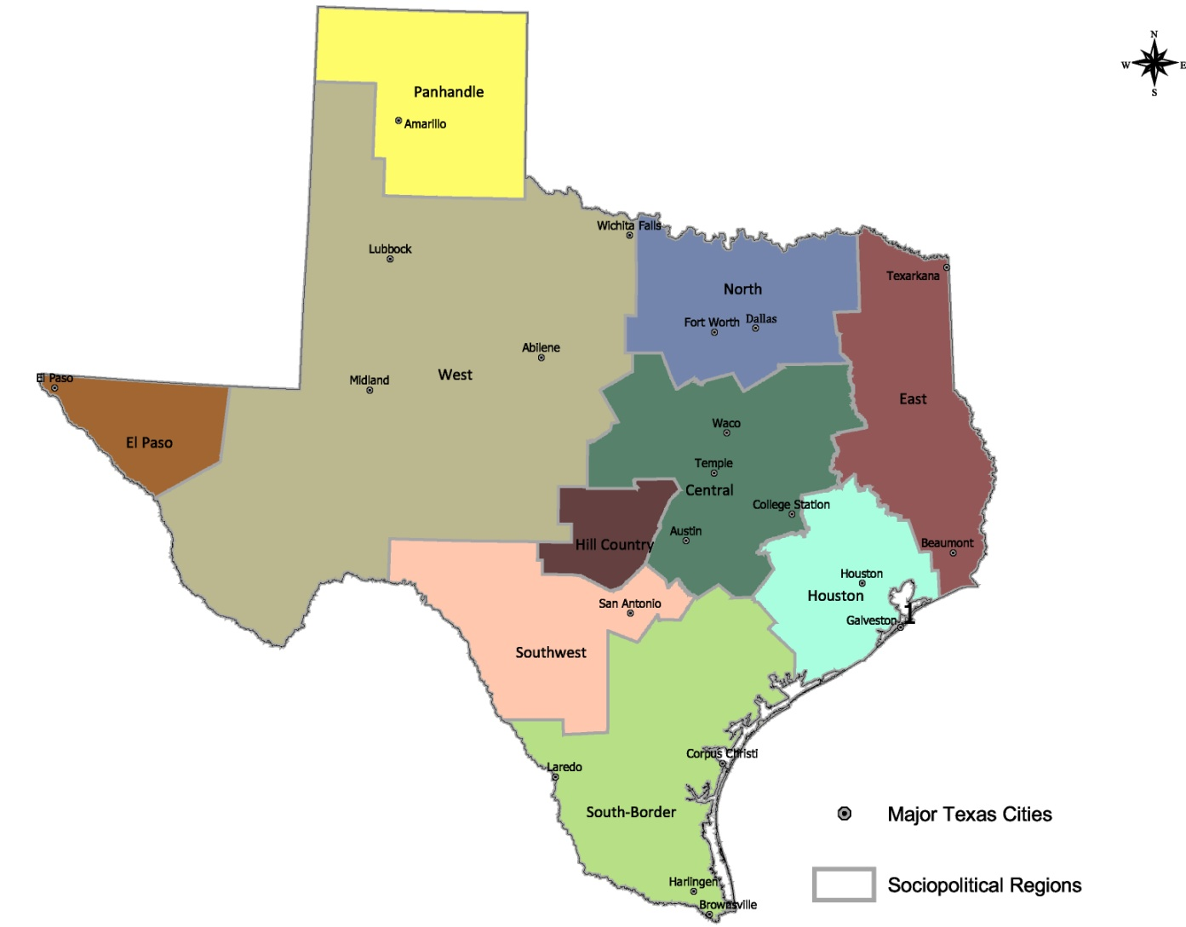
Choropleth: Categorical Data for Region

Slide 33
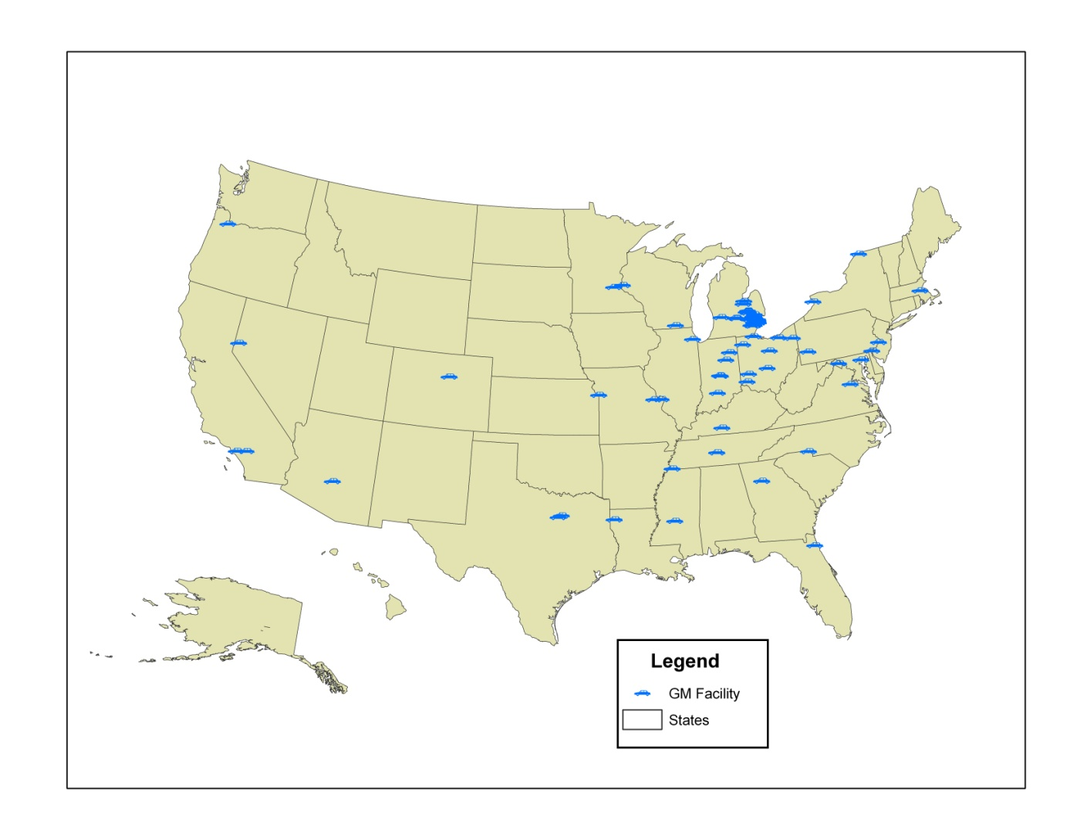

Slide 34
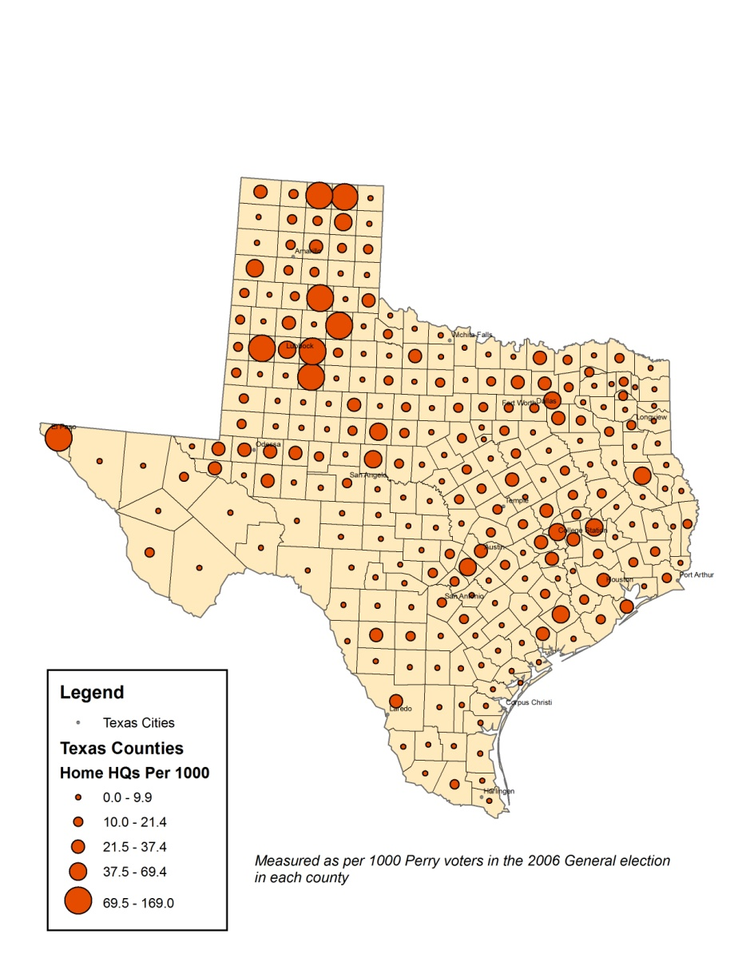
Graduated Symbol: Campaign Volunteers per 1000 Voters

Slide 35
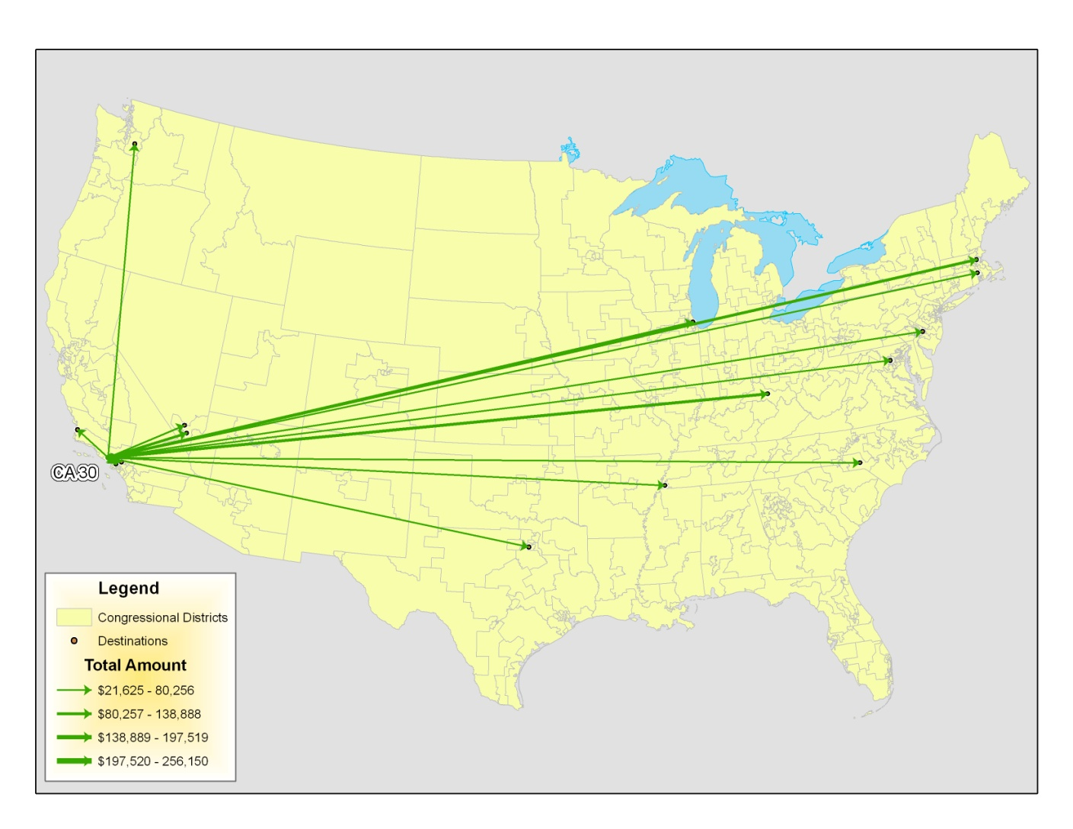
Flow Maps: Funding Flows

Slide 36
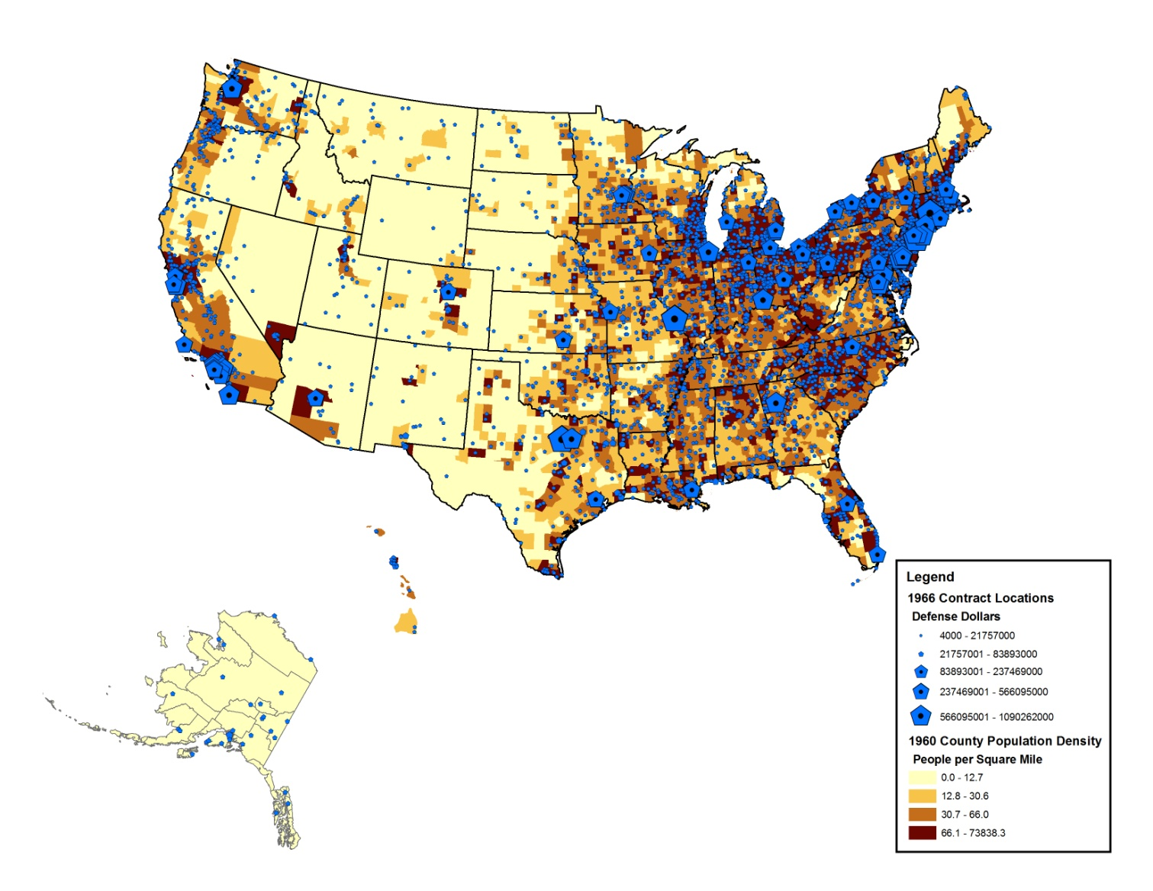
Two Variable Maps: Defense Contracts and Population Density

Slide 37
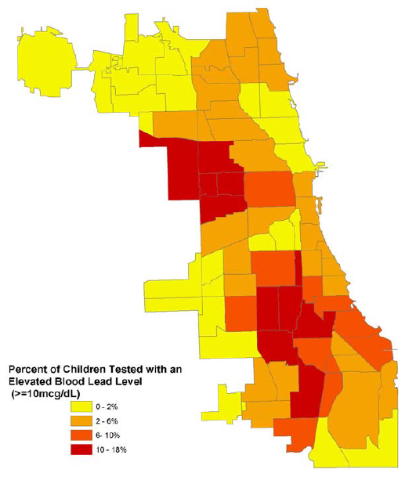
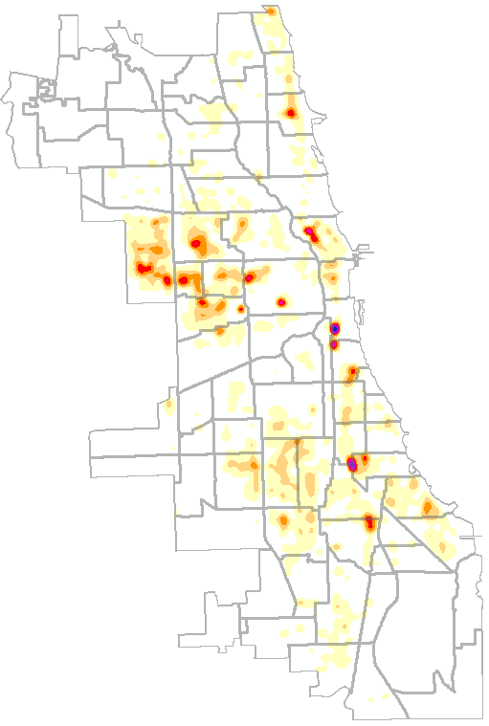
Associating Variables
More than 80 percent of homes built before 1978 contain lead paint
% families below poverty
Crime hotspots
Child lead poisoning
©

Slide 38

Natural Breaks: Identifies ‘gaps’ in the distribution of the data
Notes:
The natural breaks classification is based on each unique data set; the GIS finds the best fit based on the number of class breaks selected by the user. This classification is the default in most GIS programs and is used most frequently by crime analysts. It is most useful for exploratory or descriptive analysis, not for making comparisons across time.

Slide 39

Quantile: Quartiles or Quintiles are Common
Notes:
While most classifications are based on values in the data, quantile is concerned with the number of cases. First the data are sorted by frequency, then they are broken into classes containing an equal number of cases based on the number of classification ranges. It may be useful to illustrate this classification method with a simple example. To follow is a list of frequencies, if we use five classification ranges, then each class will have two cases.
Frequency
1
3
--
6
24
--
25
32
--
38
44
--
59
112

Slide 40

Custom: User Defined Ranges

